Slide 1
Installation and Upgrade
Christophe Fiessinger
http://blogs.msdn.com/chrisfie | http://twitter.com/cfiessinger
Product Marketing Manager
Microsoft Corporation

Slide 2
Agenda
Installation
Upgrade

Slide 3
Installation
Project Server 2013

Slide 4
Implementation: small to large
Large Farm
Multiple servers for each server role, may include multiple farms for specific purposes.
Medium Farm
Multiple servers for most server roles
Performance
Small Farm
Each server role on its own server
Multiple environments:
Development
Proof Of Concept
Pilot
Test/Staging
Production
Availability

Slide 5
Project Server version compatibility matrix
Project Desktop and Project Server
 | Project Server 2007 | Project Server 2010 | Project Server 2013 & Project Online
Project Professional 2013, Project Pro for Office 365 | Not Supported | Not Supported | Full connectivity
Project Professional 2010 | Not Supported | Full connectivity | Not Supported
Project Professional 2007 | Full connectivity | Connectivity to Server in BCM* (Project Professional 2007 SP2 required) | Not Supported
Project Server and SharePoint Server
 | Installation Requirement | Will coexist on the same farm with | Will NOT work with
Project Server 2013 | SharePoint Server 2013 Enterprise | SharePoint Server 2013 Enterprise | SharePoint Foundation 2010
Project Server 2010 | SharePoint Server 2010 Enterprise | SharePoint Server 2010 Enterprise | Office SharePoint Server 2007

Slide 6
Installation prerequisites for Project Server 2013
Installation Prerequisites are the same as for SharePoint Server 2013 Preview
Hardware and software requirements for Project Server 2013 Preview
Required Service Applications
  Project Service Application
  Excel Services (Used for Reporting)
  PerformancePoint Service (Used for Reporting)
  Secure Store Service (Used for Reporting)
  State Service (Used for Charting)

Slide 7
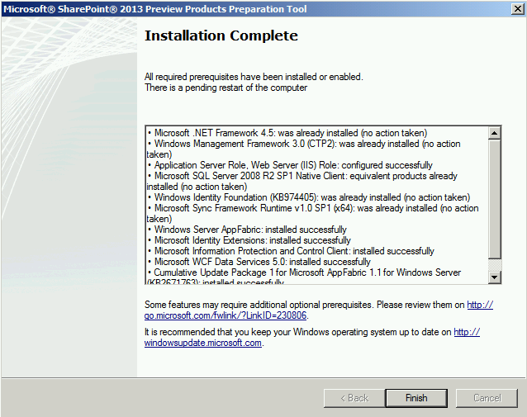
Installation Pre-requisites for SharePoint Server 2013

Slide 8
Minimum software requirements
Windows Server 2008 R2 SP1
Microsoft SQL Server 2008 R2 SP1
IE8 or latest version of Firefox, Chrome or Safari
Project Professional Windows 7 or 8
SharePoint Server 2013 Enterprise
Exchange Server 2013 (Optional)
TechNet
Lync 2010 (Optional)
Hardware and software requirements for Project Server 2013

Slide 9
Installation process
Install Windows
Install SQL Server
SharePoint Server 2013
Project Server 2013
Post Configuration
Install Windows Server
Run Windows Update
Install SQL Server and Components
Install Software Updates
Run Pre-Requisite Installer
Install SharePoint Server 2013 Enterprise Edition
Install Project Server 2013
Run SharePoint Configuration Wizard
Central Administration configuration
Project Web App
Documentation : http://technet.microsoft.com/en-us/library/ee662109(v=office.15).aspx
Powershell script : http://gallery.technet.microsoft.com/scriptcenter/Install-Server-2013-with-09d8eb59

Slide 10



Adding Project Server 2010
SharePoint Farm
Project
Excel Services
Search
Project Services
Site Collection
Site Collection

Slide 11
Adding Project Server 2013
SharePoint Farm
Project
Project
Excel Services
Search
Project Services
Site Collection
Site Collection

Slide 12
Post setup
Project Web App Core Items
Base security & users
Configure reporting
  Excel Services
  Secure Store Service
Cube Building Service (Analysis Services OLAP cubes)
Time Reporting Periods
  Required now for My Tasks/My Timesheets
Exchange Integration
  Project Server users can view Project Server tasks as Outlook tasks without ActiveX
  Requires configuration in both Project Server and Exchange Server

Slide 13
Upgrade
Project Server 2013

Slide 14
Upgrade cycle
Learn
Prepare
Test
Implement
Validate
Upgrade methods
Document environment
Build test farms
Build/upgrade farms
Troubleshooting
Downtime mitigation
Manage customizations
Plan upgrade strategy
Make items upgradable
Use real data
Evaluate techniques
Find issues early
Deploy customizations
Minimize downtime
Monitor progress
UI/UX issues
Data issues
New capabilities
Upgrade event failures

Slide 15
Upgrade overview
Only Full 5-Database Attach upgrade supported
No direct path from 2003 or 2007 to 2013
Upgrade older versions through established migration paths
Automatic database consolidation 4 databases into 1
Office Web Apps, no longer included in SharePoint, require a separate server
TechNet: Plan for upgrade to Project Server 2013 Preview
Visio PDF

Slide 16
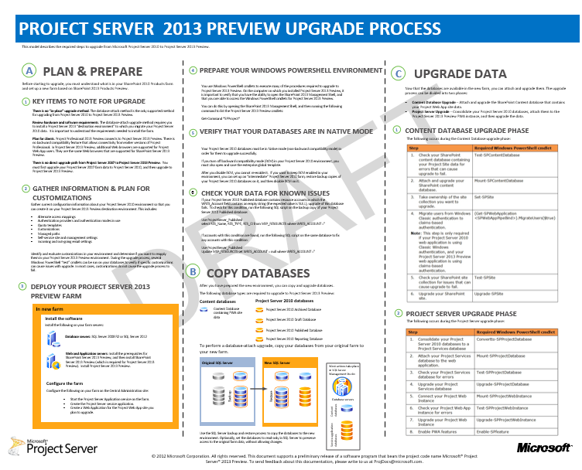

Slide 17
Upgrade Process flow and tasks

Slide 18
Requirements gathering for DB attach upgrade
Alternate access mappings
Authentication providers and authentication modes in use
Quota templates
Managed paths
Self-service site management settings
Incoming and outgoing e-mail settings
Customizations

Slide 19
Preparations for DB attach upgrade
Disable Backward Compatibility Mode (BCM)
Ensure that the account that you use to attach the databases is a member of the db_owner fixed database role for the content databases that you want to upgrade.
Check for and repair all database consistency errors.
Disable and remove Web Analytics - Having the SharePoint Server 2010 Web Analytics information in your content databases could cause an error during upgrade.
Disable and remove PowerPoint Broadcast - PowerPoint Broadcast sites cannot be upgraded to SharePoint Server 2013 Technical Preview.

Slide 20
Performing DB attach upgrade for Project DBs
1. Restore the 4 Project DBs
2. Attach the newly created Project Service Database
3. Upgrade the Project Service Database
4. Mount the Project Web App instance
5. Upgrade the Project Web App instance
6. Activate the PWA feature on the PWA site collection

Slide 21
Sample upgrade PowerShell cmdlets
Mount-SPContentDatabase -Name PWA_WSS_Content -WebApplication "SharePoint - 80"
Upgrade-SPSite $Url -VersionUpgrade
ConvertTo-SPProjectDatabase -WebApplication $wa -ArchiveDbname PWA_Archive -Dbserver $Server.Name -DraftDbname PWA_Draft -PublishedDbname PWA_Published -ReportingDbname PWA_Reporting -ProjectServiceDbname PWA_ProjectService
Mount-SPProjectDatabase PWA_ProjectService -ServiceApplication "Project Service Application"
Mount-SPProjectWebInstance -SiteCollection $Url -DatabaseName PWA_ProjectService
Upgrade-SPProjectWebInstance $Url
Enable-SPFeature pwasite -Url $Url
Grant-SPProjectAdministratorAccess -Url $Url -UserAccount domain\user

Slide 22
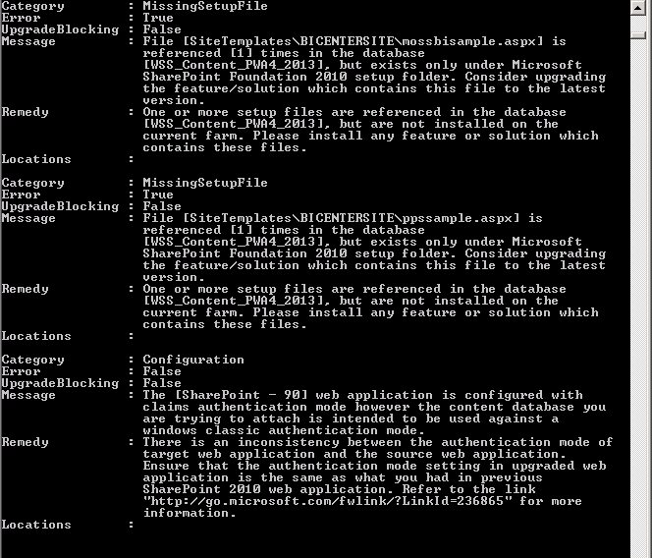
Upgrade SharePoint Content DB
Test-SPContentDatabase
Check results to look for any upgrade blocker
  Deploy any missing feature
  Missing Site Definition

Slide 23
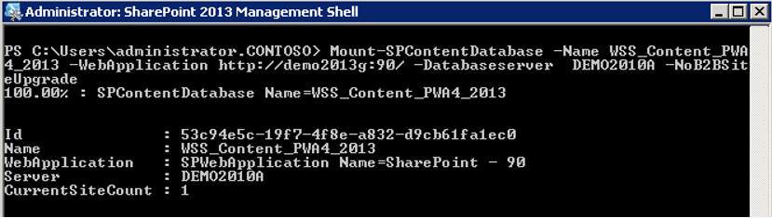
Attach Content DB – Get Rights – Migrate users
Mount-SPContentDatabase
  Database Upgrade to SP 2013 schema is done by this cmdlet
Get Site Collection admin rights (if needed)
Upgrade User accounts to Claims (if needed)

Slide 24
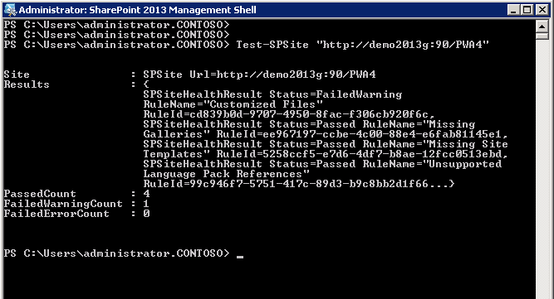
Test-SPSite Upgrade PWA Site to 2013
Test-SPSite
  Test-SPSite cmdlet ensures the Site Collection is up and running

Slide 25
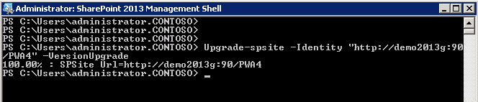
Upgrade PWA Site to 2013
Upgrade-SPSite
  Upgrade-SPSite is a new 2013 cmdlet to upgrade a Site collection from 2010 experience version to 2013 experience version
  Upgrade PWA Site collection is mandatory. PWA site collection only works using 2013 experience version.

Slide 26
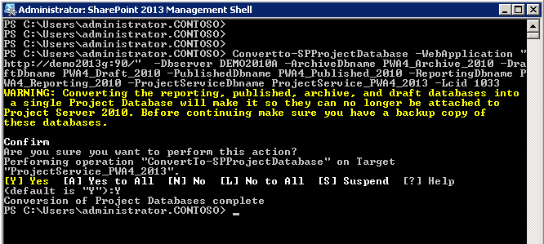
Convert 4 Project Server DBs in to 1
ConvertTo-SPProjectDatabase
  This cmdlet merges the 4 Project Server Databases into 1 single database

Slide 27
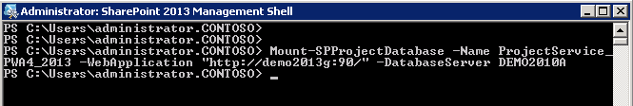
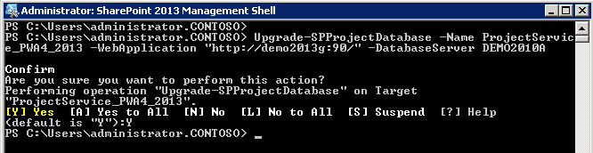
Mount and Upgrade the Project Service DB
Mount-SPProjectDatabase
  Attach the newly created Project Database
Upgrade-SPProjectDatabase
  Upgrade the database schema to 2013

Slide 28
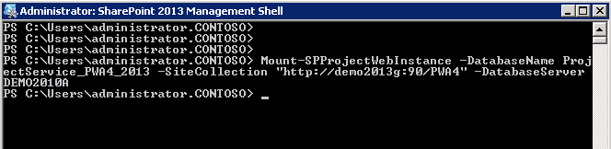
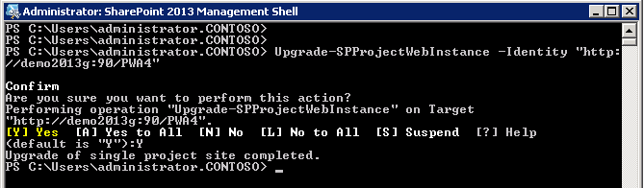
Mount and Upgrade PWA instance
Mount-SPProjectWebInstance
Upgrade-SPProjectWebInstance

Slide 29
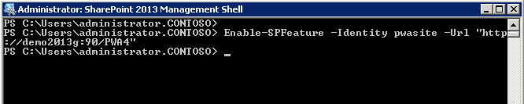
Finalize the Project Web Instance Upgrade
Enable the “pwasite” feature on the PWA Site Collection
  Enable-SPFeature –Identity pwasite –Url http://server/pwa

Slide 30
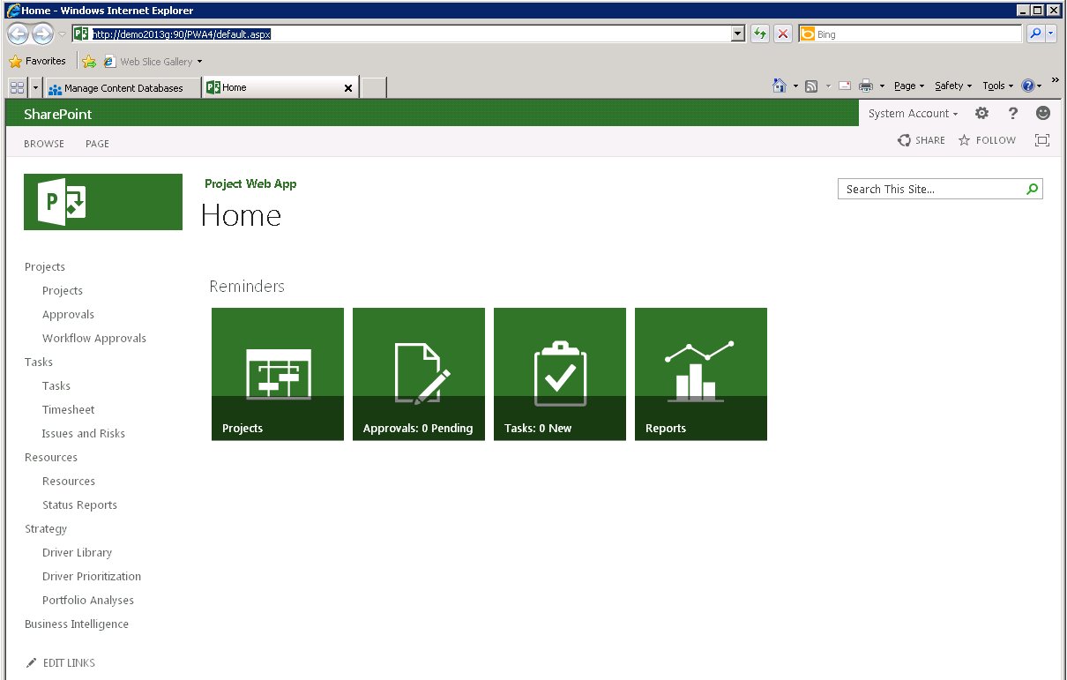
Verify the PWA Home Page

Slide 31
Summary

Slide 32
Summary
Flexible deployment options to meet your scalability & availability needs
Upgrade from Project Server 2010 using DB Attach
Upgrade Resources:
Upgrade to SharePoint 2013
Upgrade to Project Server 2013
Key Resources
Product http://www.microsoft.com/project
Blog http://blogs.office.com/b/project/
TechNet http://technet.microsoft.com/en-us/projectserver/fp123546
MSDN http://msdn.microsoft.com/en-us/office/aa905469
Forums http://social.technet.microsoft.com/Forums/en-US/category/project

Slide 33

© 2012 Microsoft Corporation. All rights reserved. Microsoft, Windows, Windows Vista and other product names are or may be registered trademarks and/or trademarks in the U.S. and/or other countries.
The information herein is for informational purposes only and represents the current view of Microsoft Corporation as of the date of this presentation. Because Microsoft must respond to changing market conditions, it should not be interpreted to be a commitment on the part of Microsoft, and Microsoft cannot guarantee the accuracy of any information provided after the date of this presentation. MICROSOFT MAKES NO WARRANTIES, EXPRESS, IMPLIED OR STATUTORY, AS TO THE INFORMATION IN THIS PRESENTATION.

